Slide 1


Ransomware
-Sanil Almeida

Slide 2






What is Ransomware?
Can affect:
Type of malware
Removable media
PC
Devices on network
Encrypts/locks files
“Internet of Things” devices
Holds files for ransom

Slide 3





How Do I Get Ransomware?
Spam & phishing emails
Unpatched security vulnerabilities
On the web (malicious ads & P2P)

Slide 4

IT’S COMMON
39% of phishing attacks contained ransomware.
Why Should You Be Concerned?
IT’S GLOBAL
It is estimated that damages will cost more than $ 8 billion globally in 2022.
IT’S EXPENSIVE
200k+ victims, 150+ countries.

Slide 5
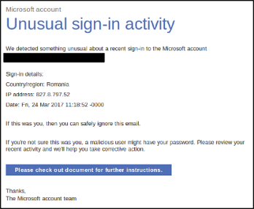

Recognizing Malware
Phishing Emails

Slide 6
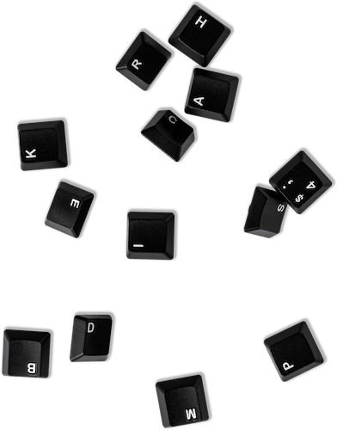



Cost of Ransomware
To the individual:
Money
Typically, <$1,000 US
Time
Corruption or loss of data

Slide 7
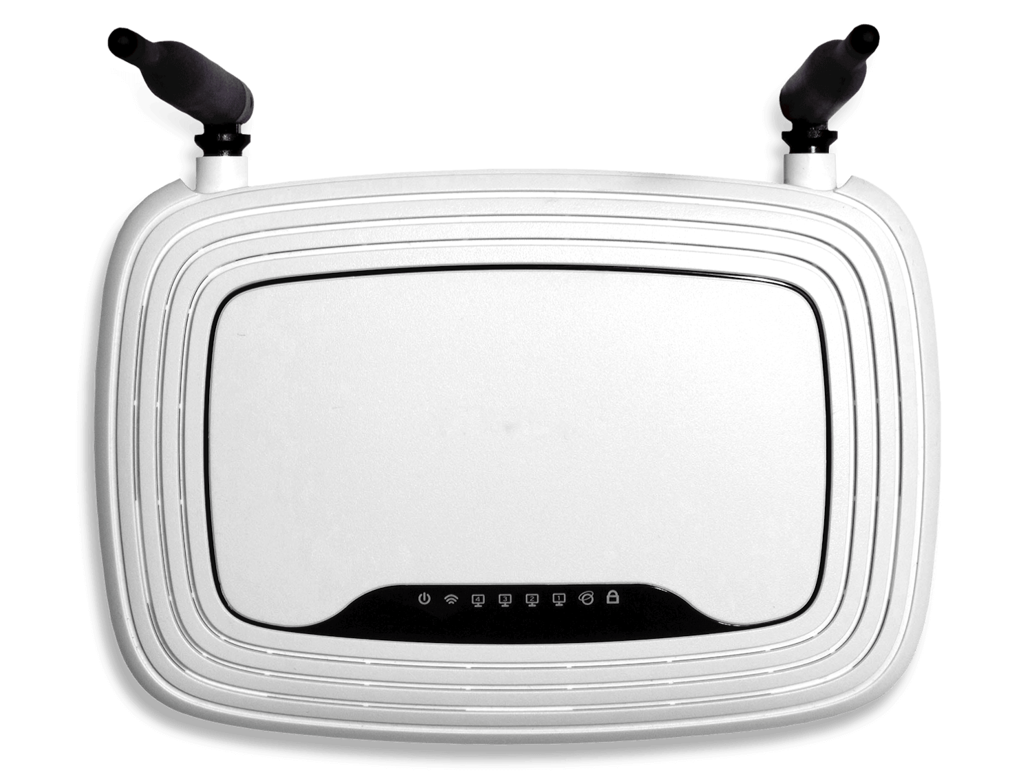






Cost of Ransomware
To the enterprise:
Time
Reputation
Corruption or loss of data
Legal implications
Suspension of service
Thousands/millions of dollars

Slide 8

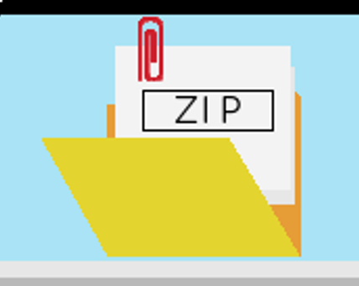




Preventing Ransomware Infections
Avoid suspicious file attachments & links
Say no to executables, scripts, macros
Browse carefully
Keep software up-to-date

Slide 9
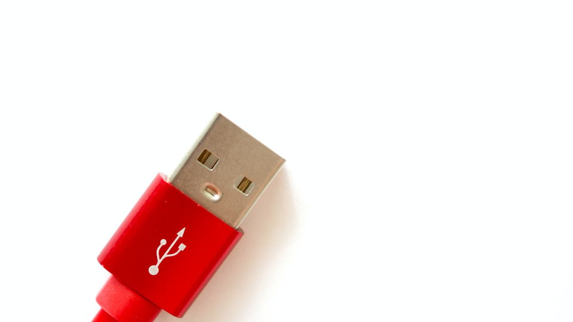

Back It Up!
Back up files regularly
Keep redundant backups if possible
Disconnect backups when not in use

Slide 10
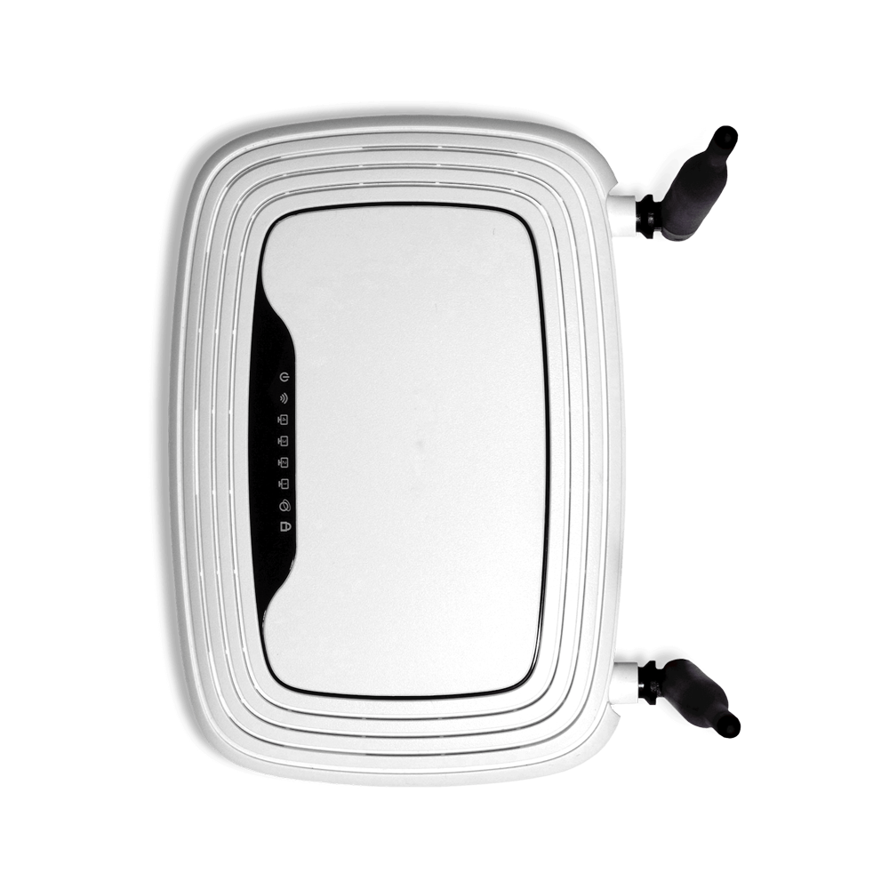


If It Happens to You…
Disconnect from network and power
Report incident immediately
Eject physical media (flash drives, etc.)

Slide 11





Should You Pay the Ransom?
Paying ransom is risky
May leave other malware behind
No guarantees
Prevention is the best cure
Files may still be corrupted

Slide 12
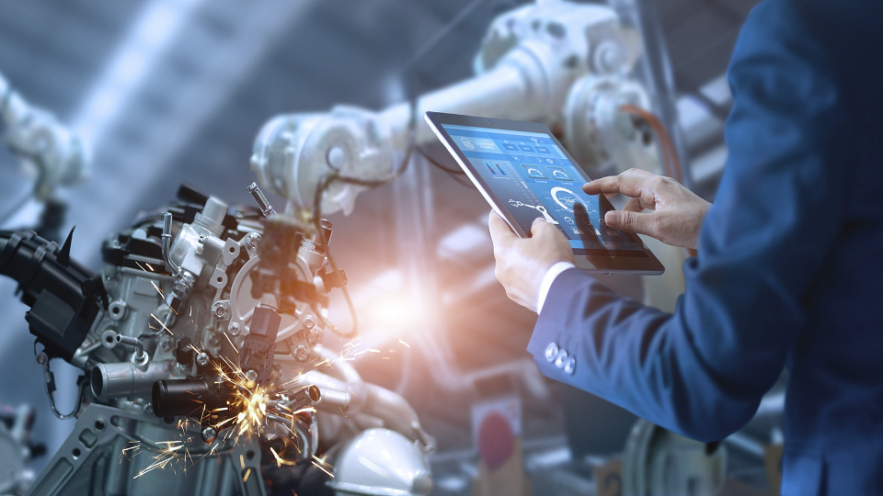

Stop Ransomware by Reporting Threats
Report any suspected threats
Help stop attacks
Protect your co-workers
Protect customer data

Slide 13
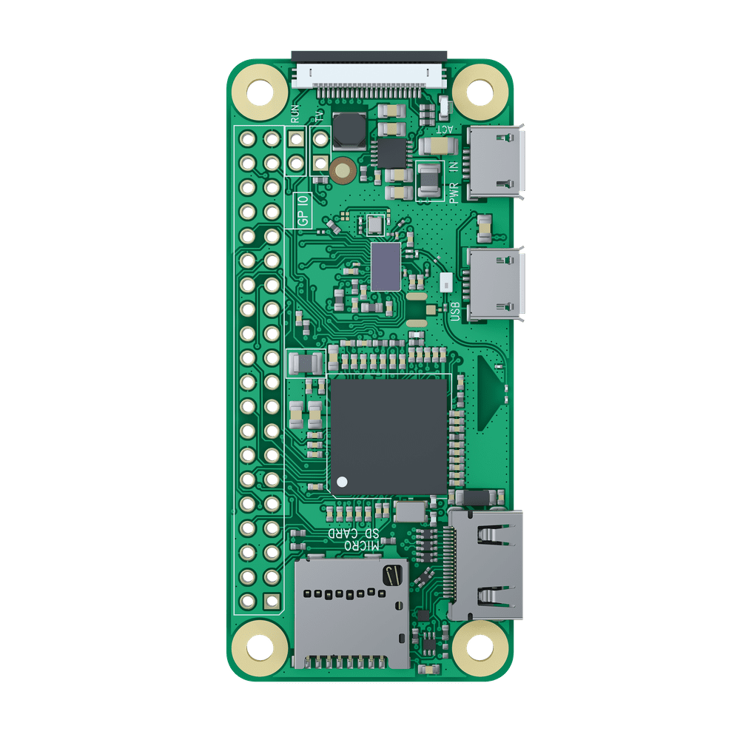



Related Resources
Whitepapers:
Blogs:
CBT:
Verizon’s Data Breach Investigations Report
Phish Me Clients are Reporting Ransomware Emails
https://cofense.com/download/cbt-ransonware
Global Ransomware Damage Costs Predicted to Exceed $8 Billion: Cybersecurity Ventures
Sigma Ransomware Resurfaces Following Three Month Disappearance
An Osterman Research Paper: The rise of threats against emails

Slide 14
DEMO!
QUESTIONS?

